Slide 1
WELCOME TO
NextHikes IT Solutions

Slide 2
Bike Sharing Demand Analysis Using Excel
A Data Science Project
By: [Chandni Joshi]

Slide 3
Introduction
Bike-sharing systems are increasingly popular in urban areas.
Understanding rental demand helps operators optimize availability, reduce shortages, and improve customer experience.

Slide 4
Problem Statement
To predict bike rental demand based on environmental and temporal factors.
Objectives:
- Build a predictive model for bike rental demand.
- Identify key factors affecting usage patterns.
- Provide actionable insights for operations optimization.

Slide 5
Dataset Overview
Dataset: Merged dataset 1,2,3 , final data set
Records: ~8,760 (hourly for 1 year)
Main Features: datetime, season, holiday, workingday, weather, temp, humidity, windspeed, count (target).

Slide 6
Dataset Preview
Shown separately as an interactive table (first 50 rows).

Slide 7
Data Preprocessing
- Checked for missing values and outliers.
- Converted datetime column to extract hour, day, month, and year.
- Encoded categorical variables like season and weather.
- Normalized numerical features.

Slide 8
Exploratory Data Analysis (EDA)
Performed EDA to understand relationships:
- Demand is higher during working hours.
- Clear weather and moderate temperatures increase rentals.
- Seasonal patterns visible across months.

Slide 9
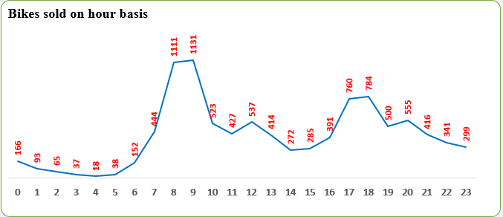
Visualization: Hourly Pattern

Slide 10
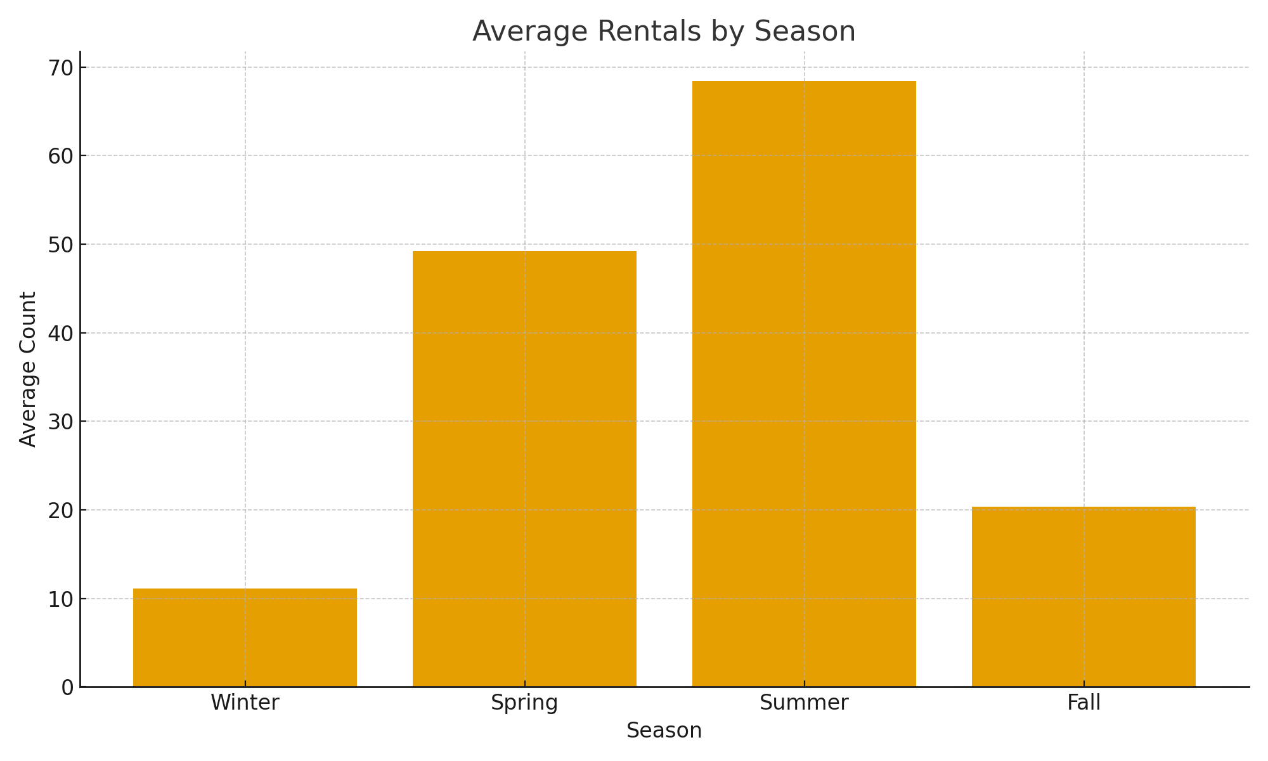
Visualization: Rentals by Season

Slide 11
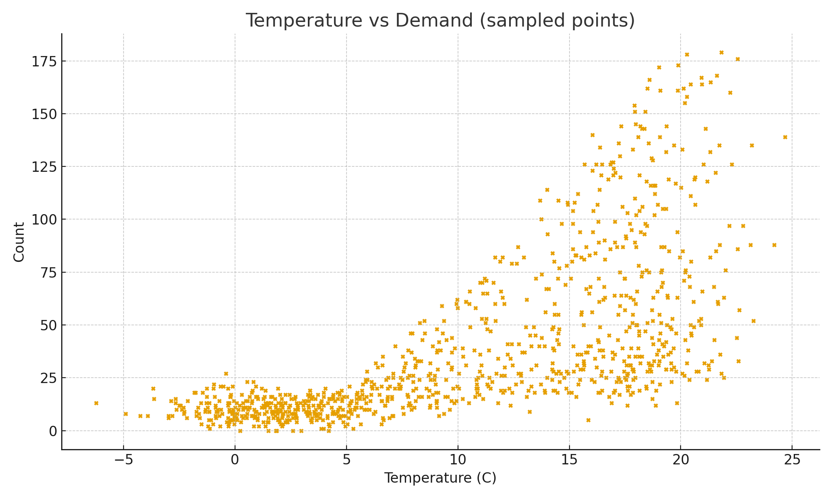
Visualization: Temperature vs Demand

Slide 12
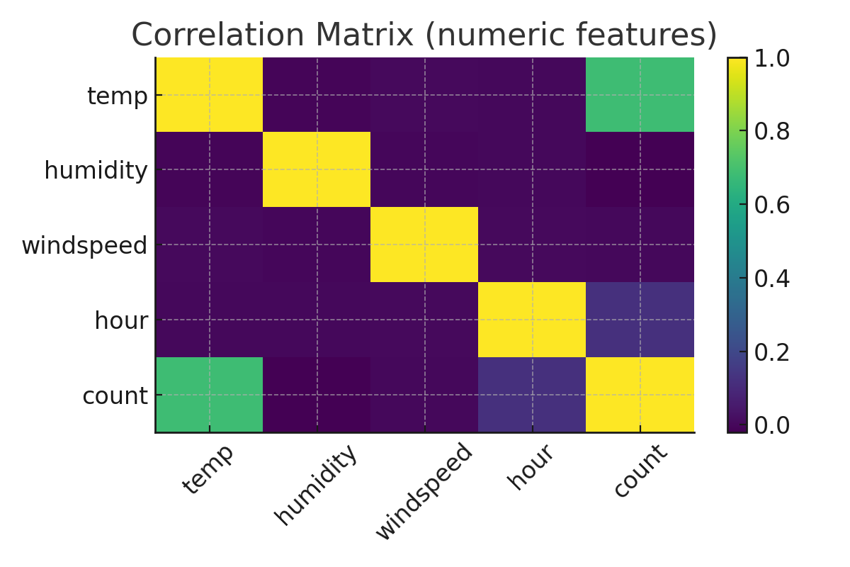
Visualization: Correlation Matrix

Slide 13
Feature Selection
- Removed highly correlated or less impactful variables.
- Selected key predictors: temp, humidity, weather, hour, season, workingday.
- Split dataset into training (80%) and testing (20%).

Slide 14
Model Building
Algorithms used:
- Linear Regression
- Random Forest Regressor
- Gradient Boosting
Evaluated models using R² score and RMSE.

Slide 15
Key Insights & Recommendations
- Temperature and weather strongly influence demand.
- Peak hours: 8 AM and 6 PM (commuting times).
- Weekdays show higher rentals compared to weekends.
- Use weather forecasts to anticipate demand fluctuations.

Slide 16
Conclusion & Future Scope
Excel learning models can effectively predict bike rental demand.
Future: Deep learning, multi-city analysis.

Slide 17
THANK YOU

